Slide 1
M.S.P.V.L POLYTECHNIC COLLEGE REVIEW I : 12.02.2025
PROJECT TITLE : Academic Planner Advisor

Slide 2
Academic Planner Advisor (Automatic Timetable Generator)
PROJECT GUIDE :
Mrs.Kohila
TEAM MEMBERS :
1.Mohamed Sithikka .A
2.Kanitha.S
3.Jebashini.J
4.Maha Lakshimi.K
5.Kalaiyarasi.R

Slide 3
SYNPOSIS
Our aim is to come up with a feasible solution for creating a schedule in a university department. We have taken up this problem since we are aware that it is a persistent problem in educational institutions. It helps to timetabling problem for a university or college
The Automated College Timetable Generator is a sophisticated system designed to simplify and optimize the scheduling process in educational institutions. It automatically creates efficient class schedules while accounting for instructor availability. It resolves scheduling conflicts and significantly reducing administrative burdens. The auction seeks to find a buyer for this innovative solution, offering an opportunity for colleges to enhance operational efficiency, minimize scheduling issues, and save time and resources.

Slide 4
SOFTWARE REQUIRED
Programming Language : Python
Frontend : HTML/CSS for basic web page structure and styling, JavaScript for
interactive elements.
Backend : DB browser(SQLite)
Framework : flask

Slide 5
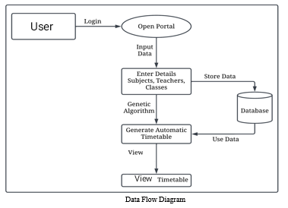
FLOWCHART

Slide 6
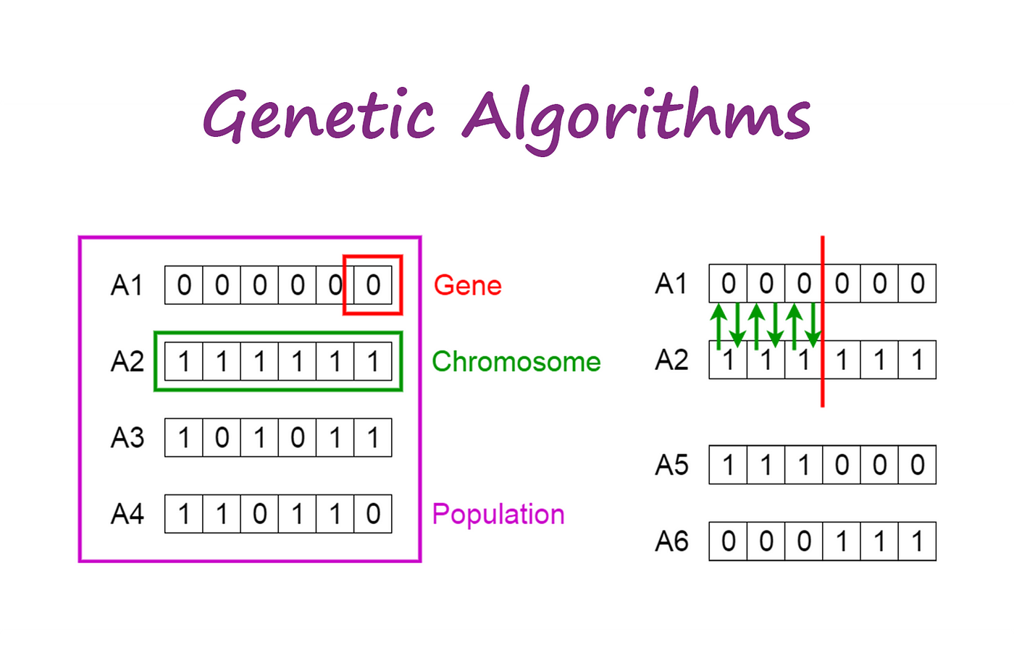
GENETIC ALGORITHM
A Genetic Algorithm (GA) is an optimization technique inspired by the process of natural selection in biology. GA is particularly useful for scheduling problems, like an Automatic Timetable Generator, because it efficiently searches for the best possible timetable while minimizing conflicts.

Slide 7
Why Use Genetic Algorithm in Timetable Generation?
Handles Constraints Efficiently – Ensures that teachers, classrooms, and subjects do not overlap.
Optimizes Scheduling – Finds the most balanced and conflict-free timetable.
Scalable – Can be applied to large datasets (e.g., university timetables).
Fast Convergence – Produces good results in a reasonable amount of time.

Slide 8
Existing System: Manual Timetable Scheduling
In many institutions, timetables are created manually using spreadsheets or whiteboards.
Administrators or faculty members allocate classes based on availability and preferences.
Conflicts (e.g., double-booking of teachers, room clashes) are resolved manually.

Slide 9
Solution
Fast & Efficient :
Uses algorithms to generate schedules in minutes instead of hours/days
Error-Free Scheduling :
Automatically checks for conflicts, like double-booking of rooms or teachers.
Better Resource Allocation :
Ensures proper utilization of available faculty ,classroom and time slots.
User-Friendly Interface :
Allows administrators and teachers to easily input data and generate schedules.

Slide 10
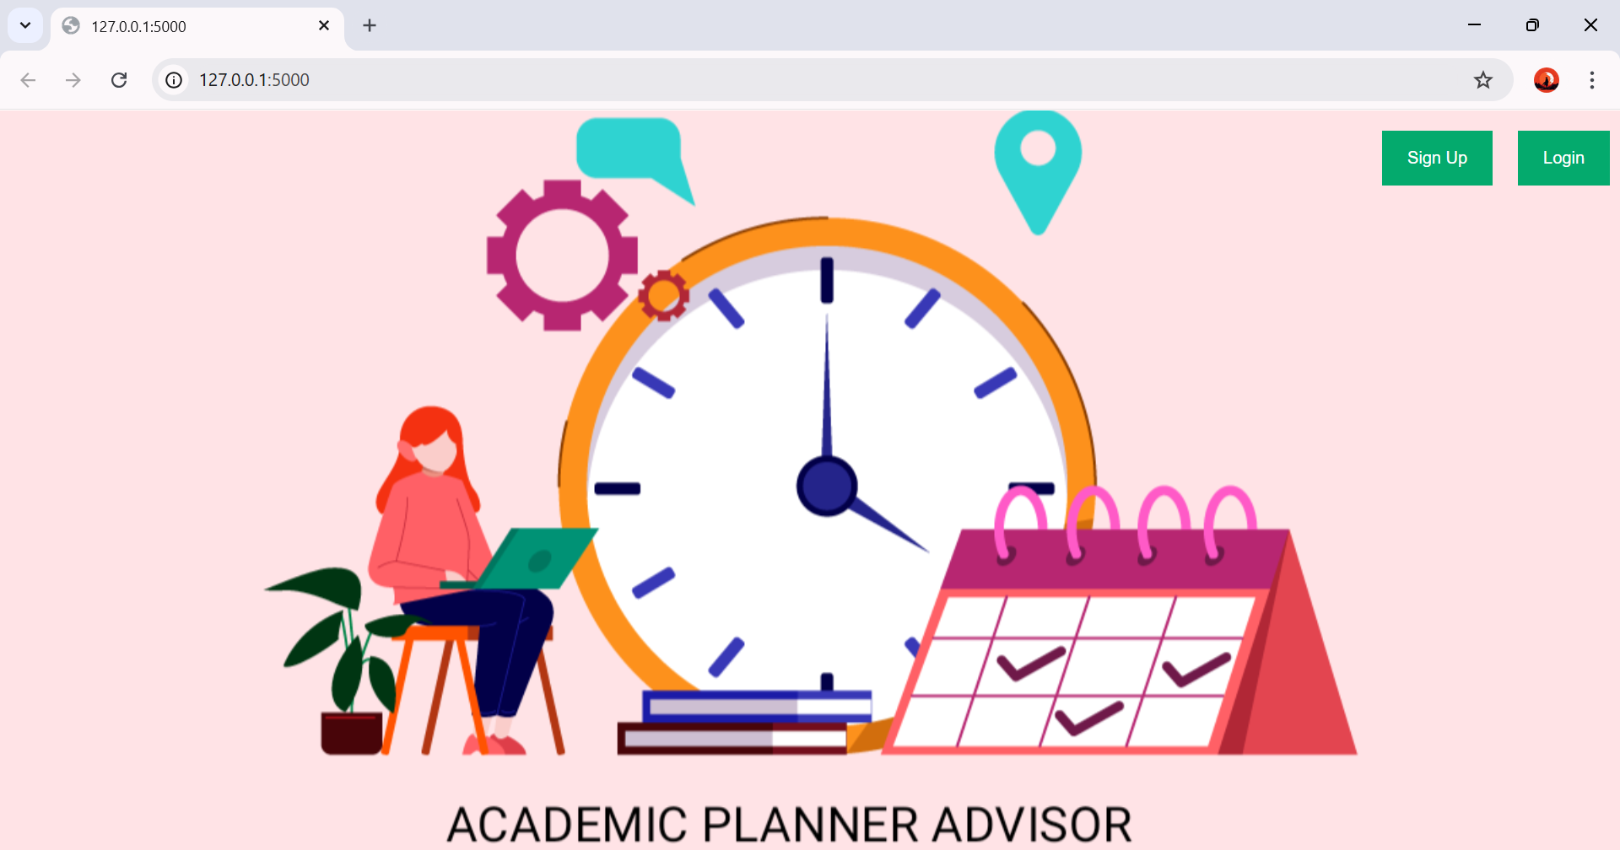
HOME PAGE

Slide 11
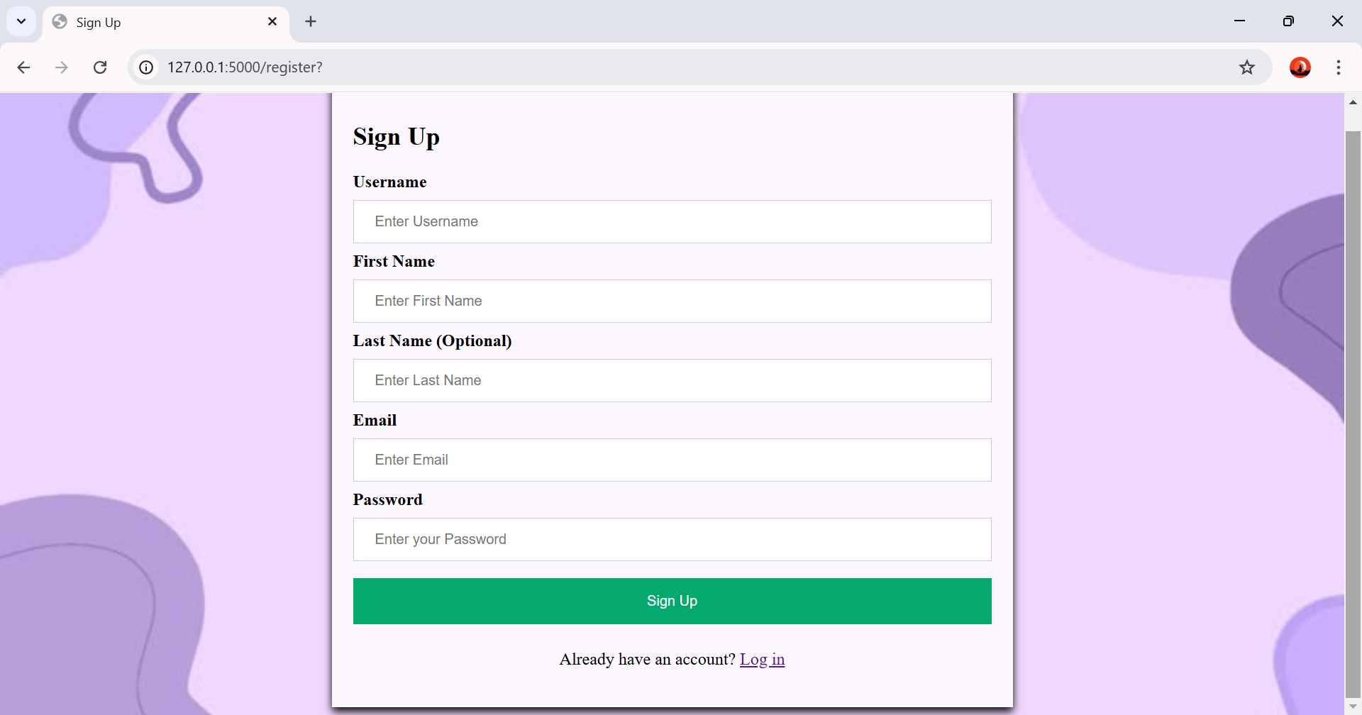
SIGN UP PAGE
To create a user account to use the web application .

Slide 12
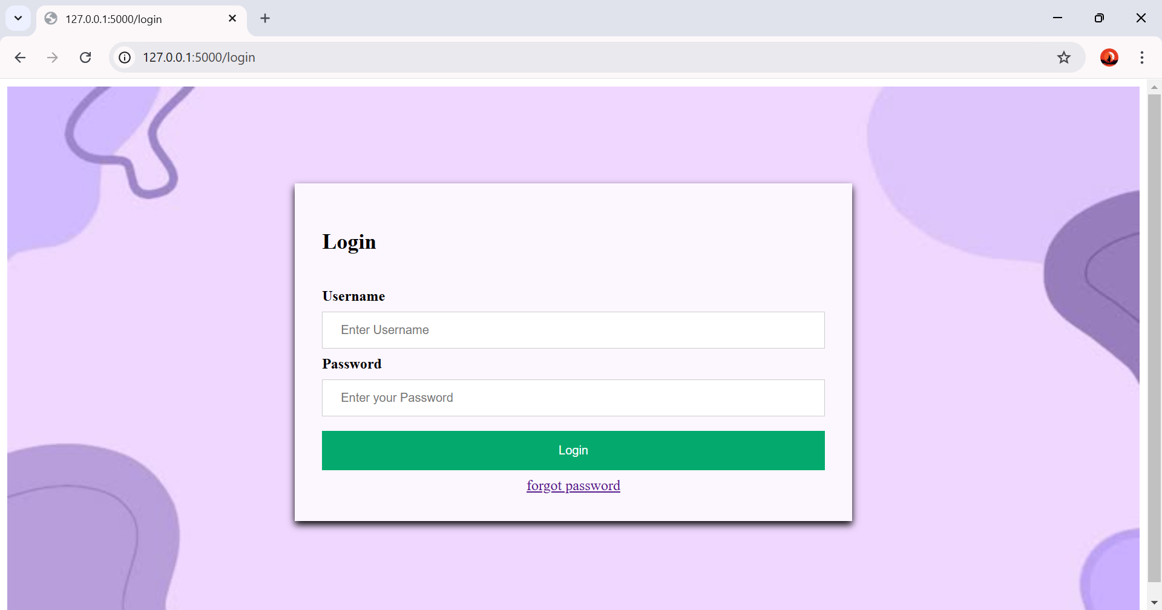
LOGIN PAGE

Slide 13
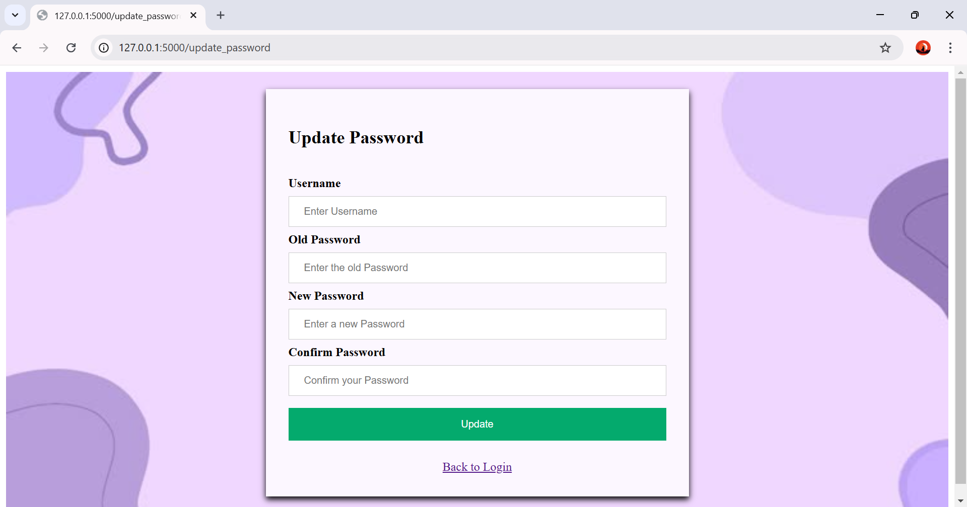
UPDATE PASSWORD
To change the old password in case user forgot it.

Slide 14
THANK YOU!

Slide 15
M.S.P.V.L POLYTECHNIC COLLEGE REVIEW II : 26.03.2025
PROJECT TITLE : Academic Planner Advisor

Slide 16
STEPS TO GENERATE TIMETABLE
Step 1 : Add Subjects details (about syllabus)
Step 2 : Add Staff Details to generate staff timetable
Step 3 : Add Classroom and Lab Details to generate class and lab timetable
Step 4 : Generate Staff timetable.
Step 5 : Generate Lab timetable.
Step 6 : Generate Class timetable.

Slide 17
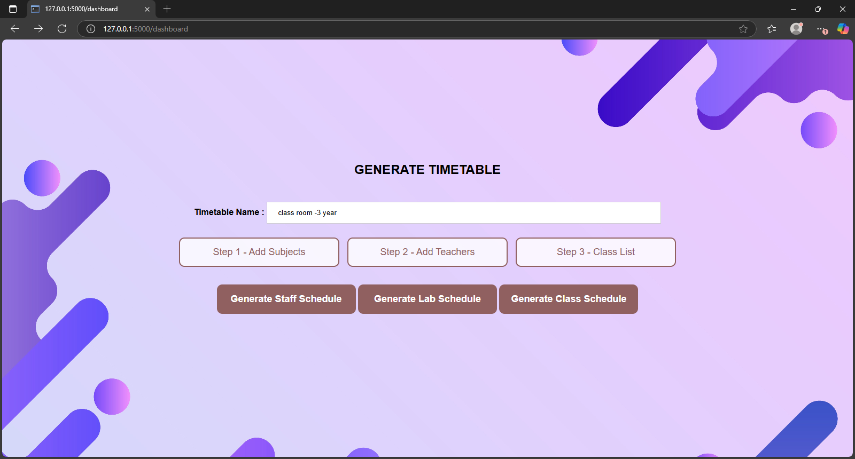
MAIN DASHBOARD

Slide 18
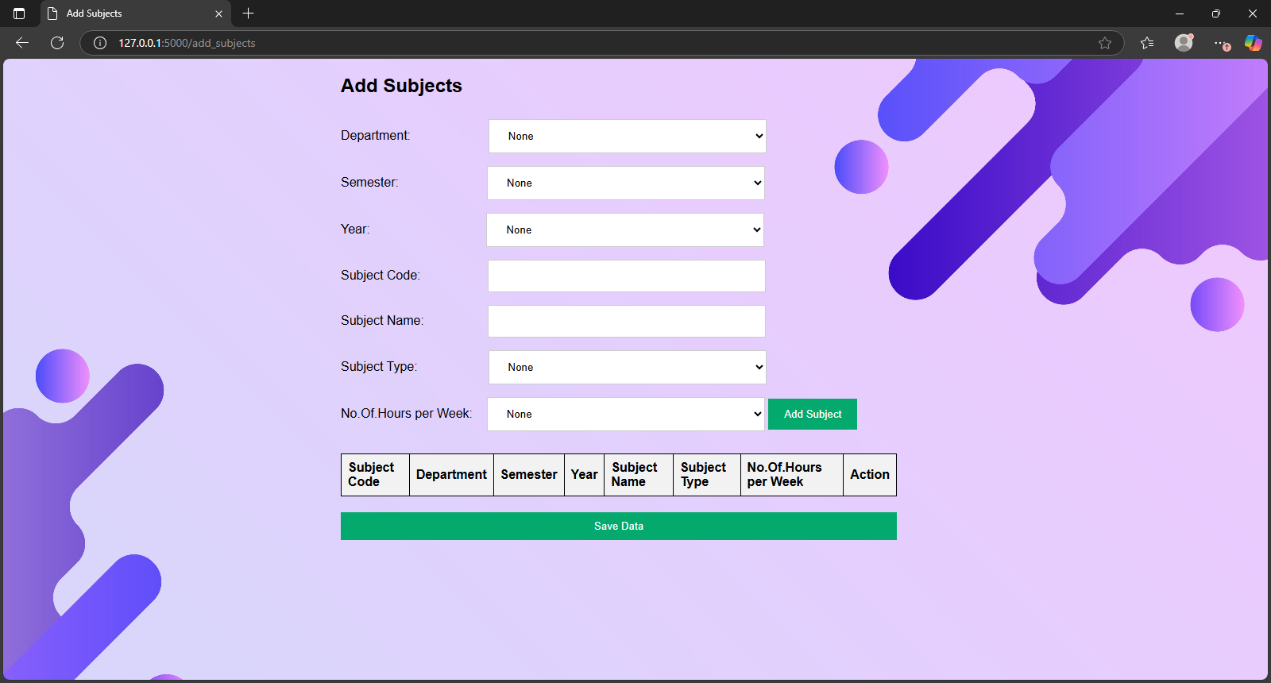
ADD SUBJECT

Slide 19
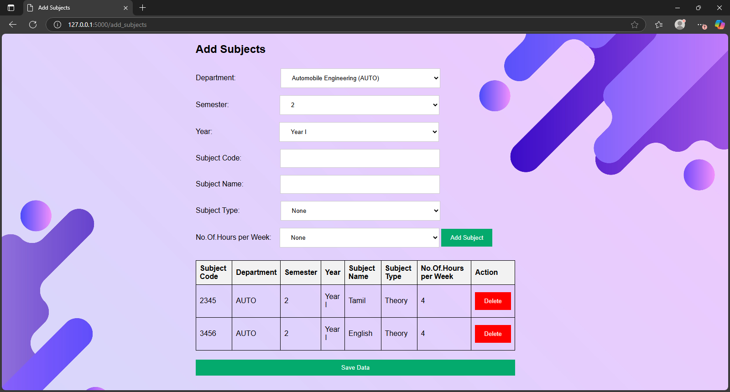

Slide 20
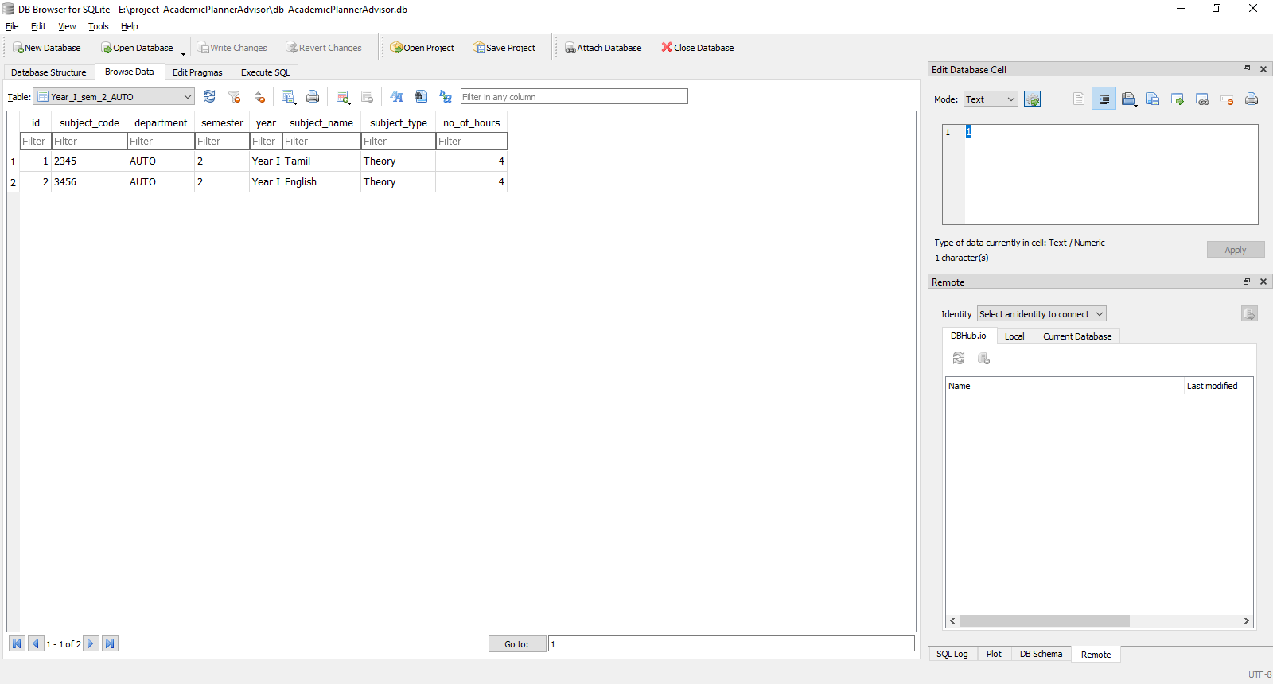
Subject details Stored In Database

Slide 21
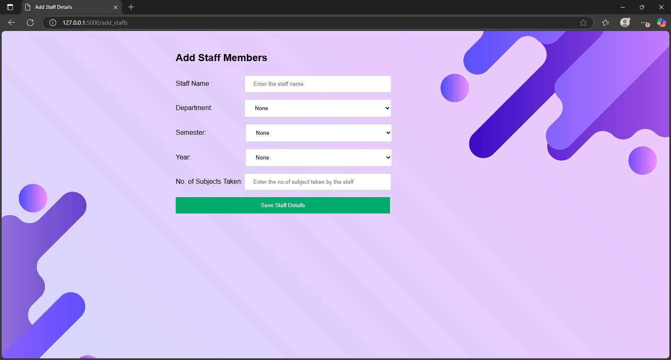
STAFF DETAILS

Slide 22
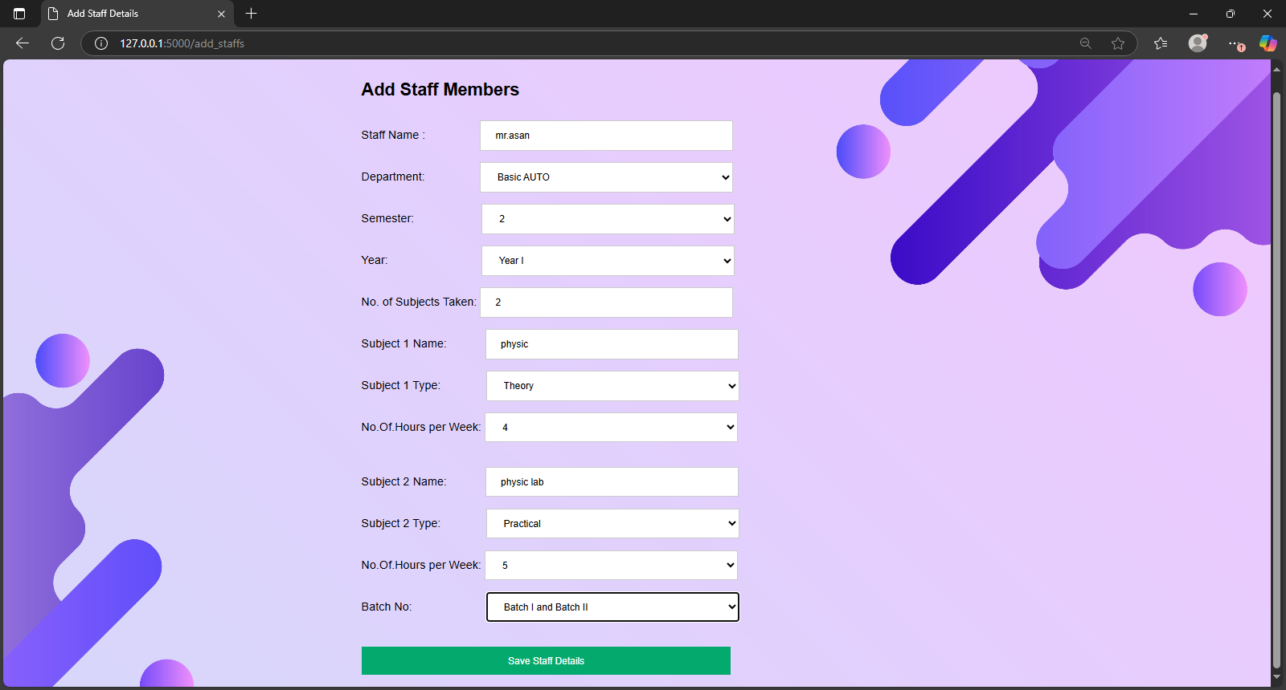

Slide 23
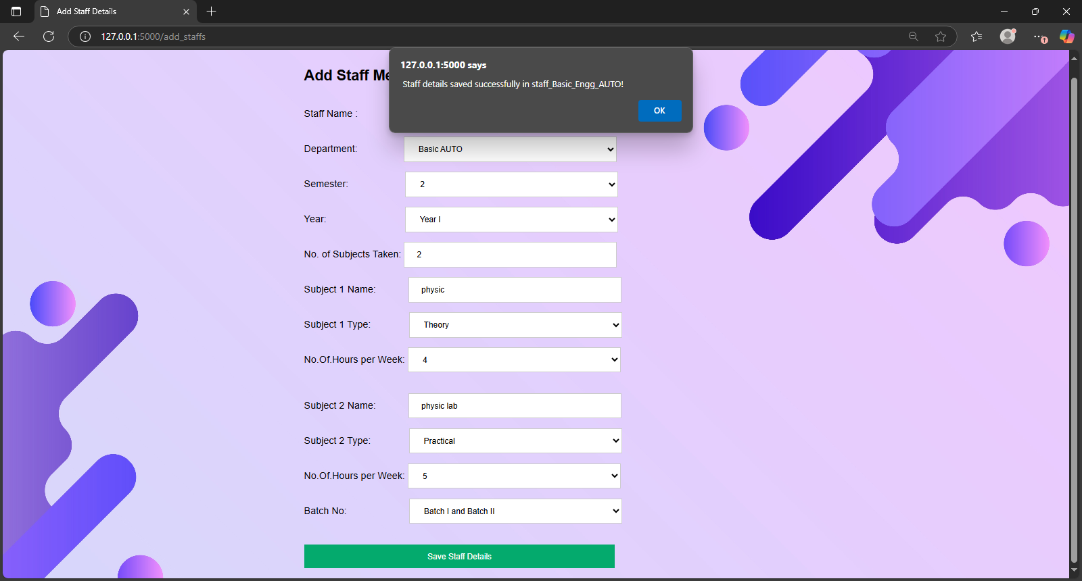

Slide 24
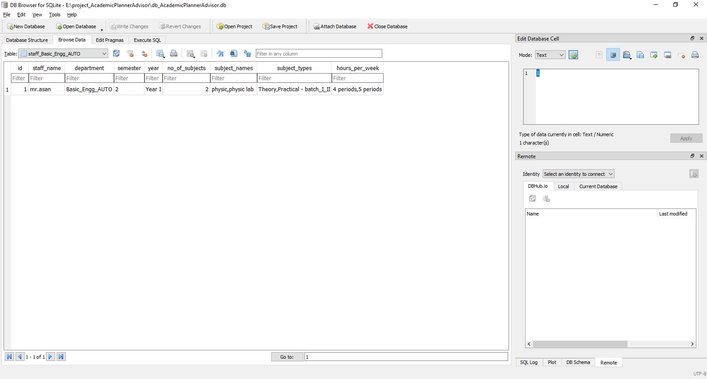
Staff Data Stored In Database

Slide 25
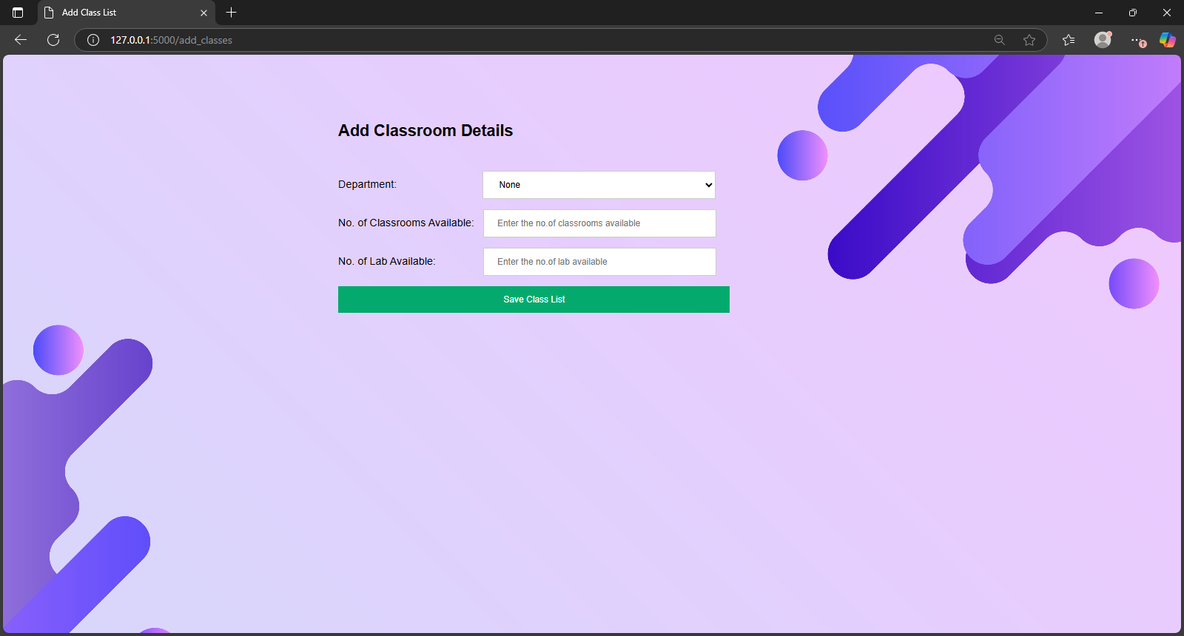
ADD CLASSLIST

Slide 26
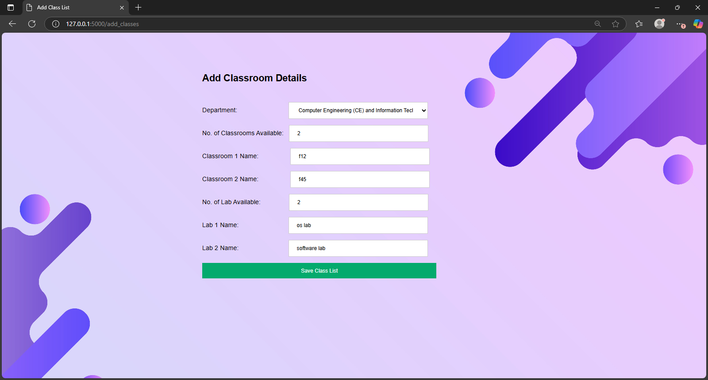

Slide 27
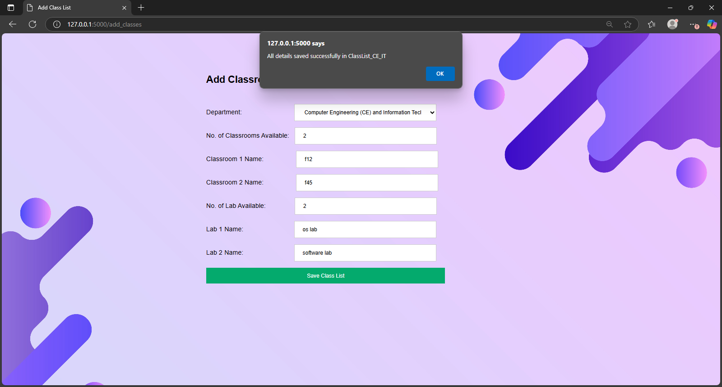

Slide 28
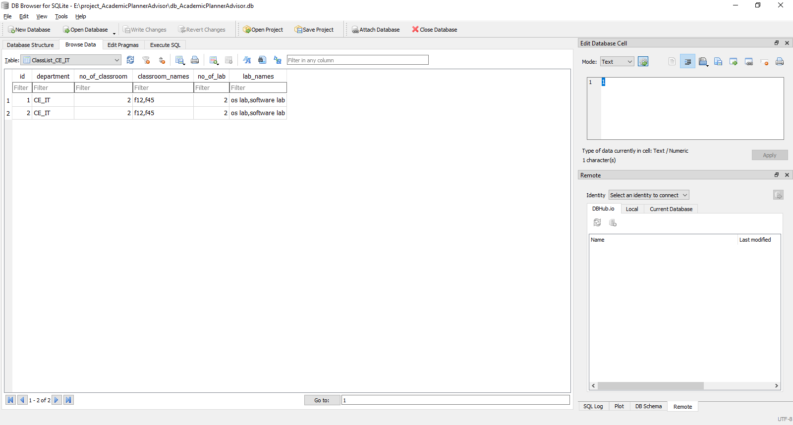
Classroom And Lab Details Stored In Database

